Slide 1
output layer
Hidden layer
Input layer

Slide 2
Hidden layer
output layer
Input layer

Slide 3
Hidden layer
Input layer
output layer

Slide 4
o
W
W
W
W
W
Unfold
....
....
V
V
V
V
V
U
U
U
U

Slide 5
Backpropagation
Real images
Sample
Discriminator
Discriminator Loss
Random input
Generator
Sample
Generator Loss

Slide 6
Real images
Sample
Discriminator Loss
Discriminator
Random input
Generator
Sample
Generator Loss

Slide 7
Real images
Sample
Discriminator Loss
Random input
Generator
Sample
Discriminator
Generator Loss
Backpropagation

Slide 8
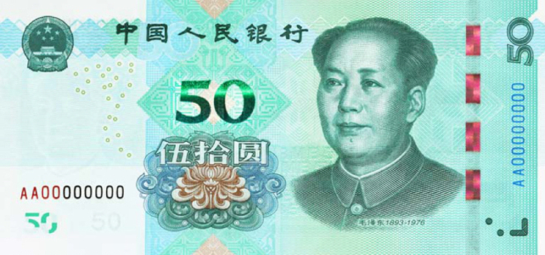
FAKE
REAL
30
FAKE
REAL

Slide 9
REAL
REAL

Slide 11
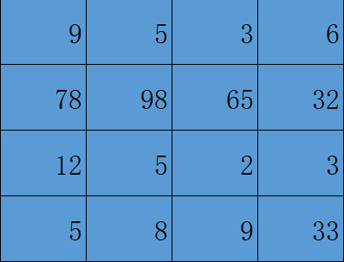
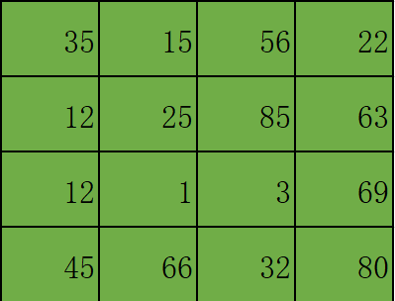
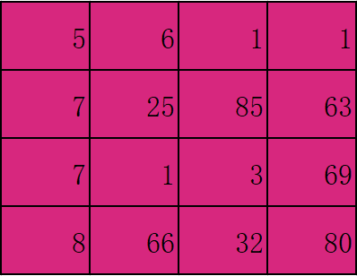
Input Image
3 Colour Channels
Height: 4 Units
(Pixels)
Width: 4 Units
(Pixels)

Slide 12
1
1
1
1
0
x1
x0
x0
0
1
1
1
1
x1
x0
x1
1
0
1
0
1
3
x1
x1
x0
1
1
1
1
1
0
1
1
1
0
Convolved
Feature
Image

Slide 13
1
1
1
1
0
x1
x0
x0
0
1
1
1
1
x1
x0
x1
1
0
1
0
1
3
4
x1
x1
x0
1
1
1
1
1
0
1
1
1
0
Convolved
Feature
Image

Slide 14
1
1
1
1
0
0
1
1
1
1
1
0
1
0
1
3
4
4
x1
x0
x0
1
1
1
1
1
4
3
5
x1
x0
x1
0
1
1
1
0
4
4
5
x1
x1
x0
Convolved
Feature
Image

Slide 15
1
1
1
1
1
1
0
0
0
1
1
1
1
1
1
0
1
0
1
1
1
1
1
1
0
1
1
1
0

Slide 16
max pooling
23
130
99
85
12
1
130
0
23
2
23
2
20
0
12
16
99
2
26
85
average pooling
9.5
38.75
32.25
34.75

Slide 17
image patch
1 layer
36x36
hidden layer 1
4 feature maps
hidden layer 2
8 feature maps
final layer
4 class units
28x28
14x14
10x10
5x5
convolution
(kernel: 9x9x1)
convolution
(kernel: 5x5x4)
max pooling
convolution
(kernel: 5x5x8)
max pooling

Slide 18
Output Volume
588x1
Output Volume
20x1
Output Nodes
5x1
Output Volume
14x14x3
Class 1
ReLU Activation Fn.
Volume-28x28x3
Class 2
Class 3
Class 4
.
.
.
.
.
.
Convolution
layer Stride 1
Max Pool
layer Stride 2
Class 5
Input Volume
32x32x1
Soft-max Layer
Soft-Max
Activation Fn
Flatten layer
Fully connected
Layer ReLU Activation Fn.

Slide 19
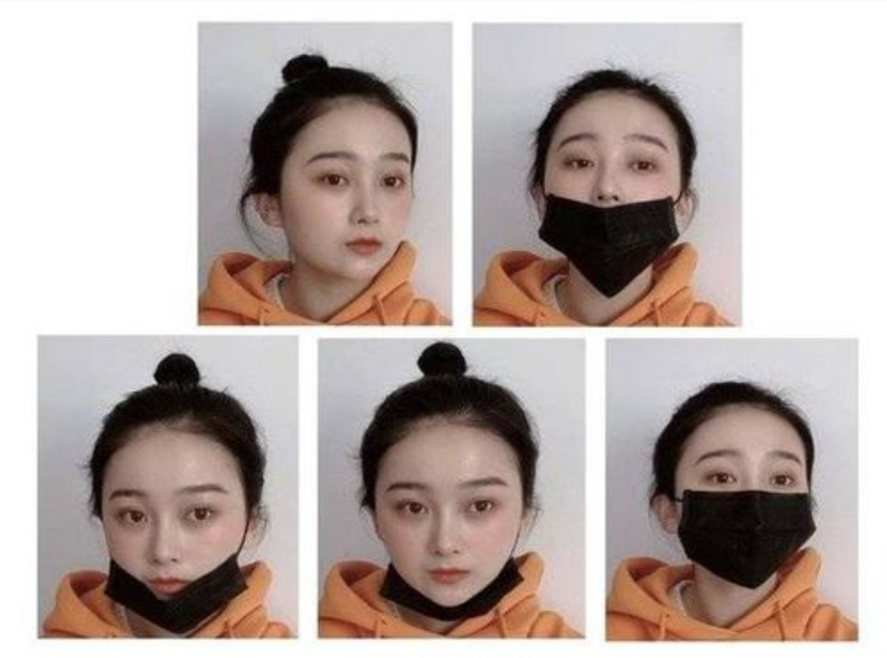
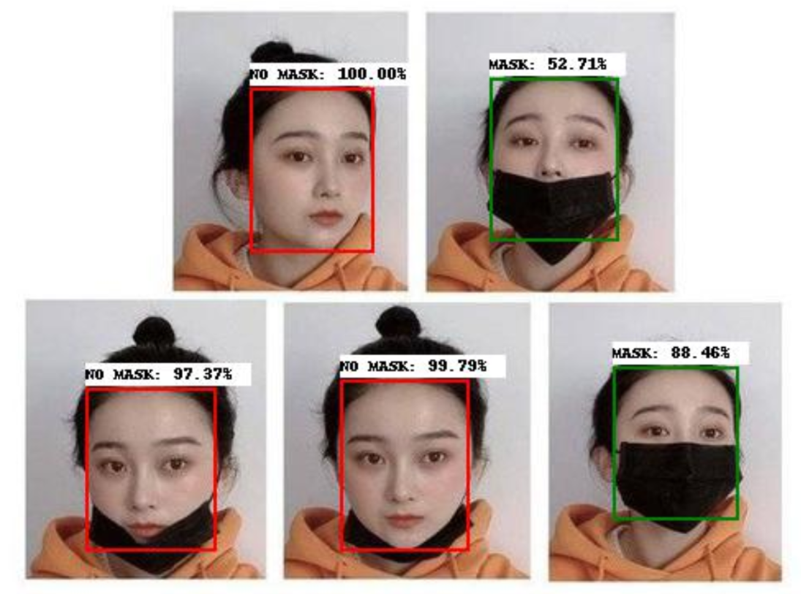

Slide 20
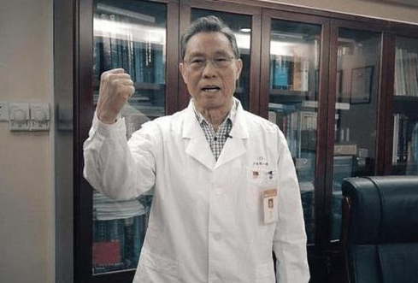
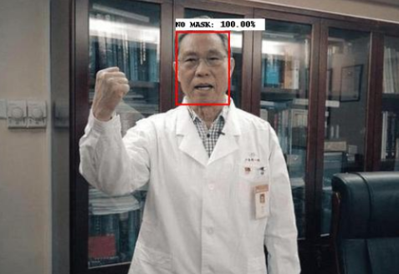

Slide 21
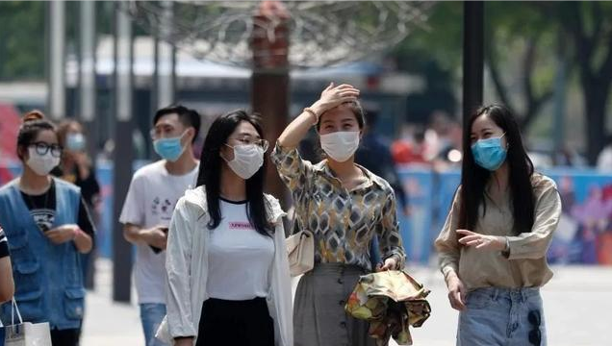
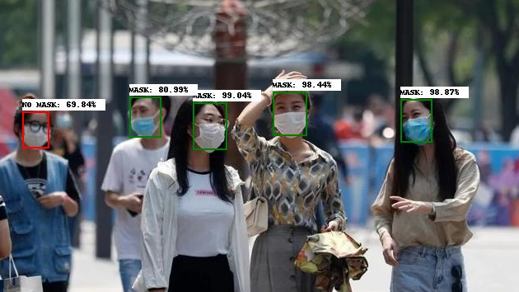

Slide 22
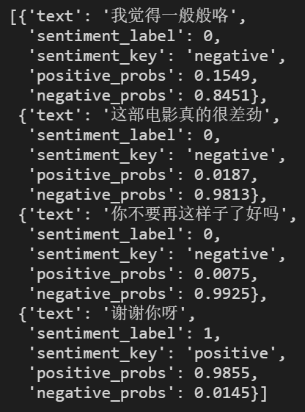

Slide 23
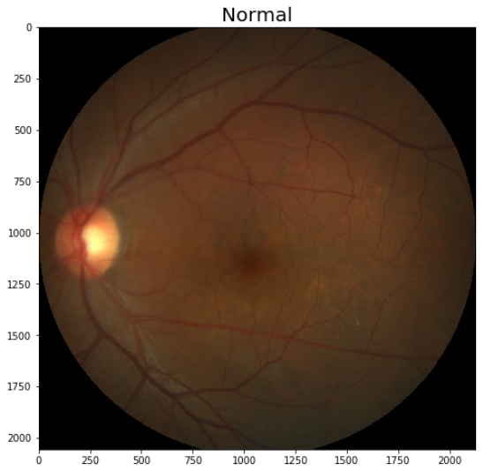
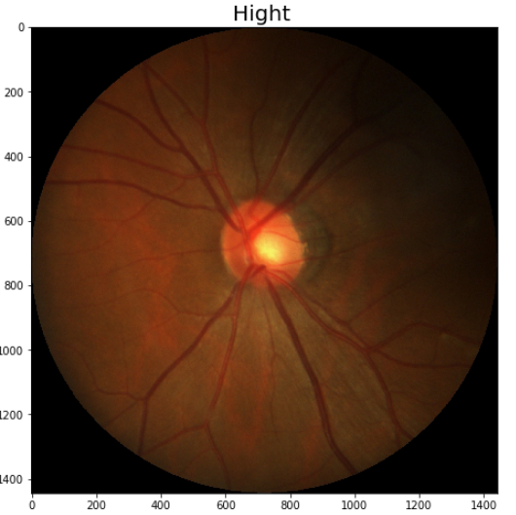
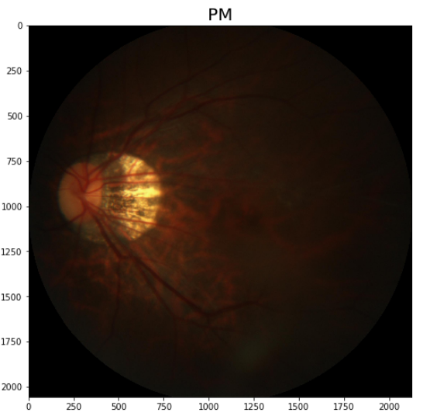

Slide 24
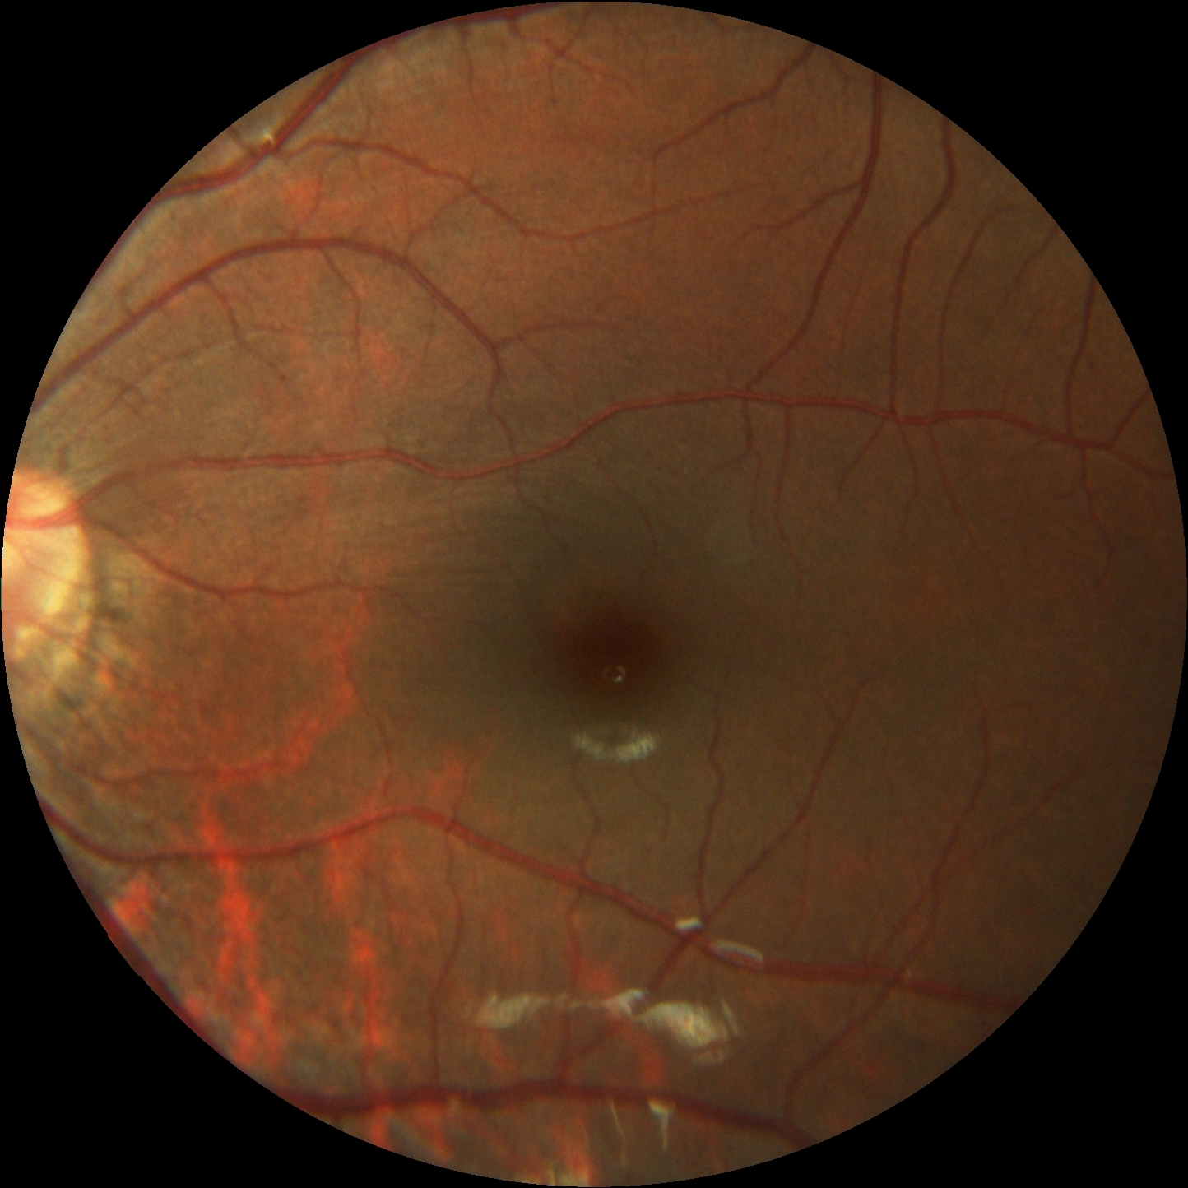
shape:106x106x16
shape:53x53x16
shape:50x50x120
imput image
shape:224x224
shape:220x220x6
shape:110 x110x6
......
outPut Shape
300000
convolution
(kernel: 5x5x6)
MaxPooling
(kernel: 2x2)
convolution
(kernel: 5x5x16)
MaxPooling
(kernel: 2x2)
convolution
(kernel: 4x4x120)

